Slide 1


Slide 2
TO
LIBRARY MANAGEMENT SYSTEM
CREATED BY:
MR.NANAVARE PRATIK DINKAR
MR.MULANI SHOYAB GULAB
UNDER THE GUIDANCE OF
PROF.C.N. REDDY

Slide 3
INDEX
INTRODUCTION
SCOPE OF SYSTEM
PURPOSE OF SYSTEM
OBJECTIVE
FACT FINDING TECHNIQUES
FEASIBILITY STUDY
DIAGRAMS
USER INTERFACE
TABLES
ADVANTAGES AND DISADVANTAGES
FUTURE SCOPE
CONCLUSION

Slide 4
INRODUCTION
A Library Management System (LMS) is a comprehensive software solution designed to facilitate the efficient and effective management of a library's resources, services, and users. In today's digital age, traditional library management, which involves manually tracking inventory, lending, and member records, can be labor-intensive and prone to errors. An LMS automates these tasks, enhancing library operations, improving user experience, and enabling libraries to serve their patrons more effectively. This introduction explores the purpose, benefits, features, and development considerations for implementing a Library Management System.

Slide 5
SCOPE OF SYSTEM
The scope of the Library Management System (LMS) encompasses a wide range of functionalities that improve library operations, support user needs, and integrate with modern technologies to create a seamless library experience. This system is designed to cater to both library staff and patrons, automating day-to-day operations while offering easy access to resources and account management for users.
Key Areas of Scope:
Resource Management
User Management
Borrowing and Lending Operations
Digital Resource Integration
Inventory Management

Slide 6
PURPOSE OF SYSTEM
The primary purpose of a Library Management System (LMS) is to streamline, organize, and automate various library operations to improve efficiency, accuracy, and accessibility. Libraries, whether academic, public, or private, have evolved from being just physical spaces for books into dynamic learning and resource hubs. A Library Management System is designed to support this evolution by addressing the many administrative and operational challenges libraries face. Here’s a detailed look at the purpose of an LMS:
The main purpose of an LMS include:
Efficient Resource Management
Enhanced User Experience
Automating Routine Tasks
Data-Driven Decision-Making
Security and Accountability

Slide 7
OBJECTIVE OF SYSTEM
The objectives of the Library Management System (LMS) are to optimize library operations, improve user experience, and enable efficient resource management. Designed as a centralized and automated solution, the LMS aims to address the challenges of traditional library systems while meeting the needs of a modern, digital library environment. The following key objectives outline the purpose and functionality of the LMS:
Automate Library Operations
Enhance User Accessibility and Engagement
Ensure Real-Time Resource Tracking and Inventory Management
Enable Data-Driven Decision Making
Integrate Digital and Physical Resources
Improve Communication with Users

Slide 8
Modules and Functionalities
User Management Module:
Catalog Management Module:
Circulation Management Module:
Search and Discovery Module:
Reservation and Renewal Module:
Notifications and Alerts Module:
Fines and Payments Module:
Reports and Analytics Module:
Inventory Management Module:
Administration and Configuration Module:

Slide 9
Modules and Functionalities
Barcode/RFID Integration Module (Optional) :
Digital Resource Management Module (Optional) :
Backup and Recovery Module:
Security and Access Control Module:
Multi-Library or Branch Management Module (Optional for large systems) :

Slide 10
Feasibility Study
The feasibility study for a Library Management System (LMS) assesses whether implementing this system is practical, cost-effective, and beneficial for a library. It evaluates the technical, economic, operational, and time feasibility to ensure the project aligns with organizational goals, resources, and constraints.
Technical Feasibility:
System Requirements:
Integration with Existing Systems:
Hardware Requirements:
Economic Feasibility :
Initial Costs:
Operational Costs
Return on Investment (ROI)

Slide 11
Feasibility Study
Operational Feasibility:
Ease of Use
Staff Training and Adaptability
Schedule Feasibility:
Implementation Timeline
Milestones
Potential Delays
Legal and Compliance Feasibility :
Data Privacy and Security
Licensing and Copyright

Slide 12
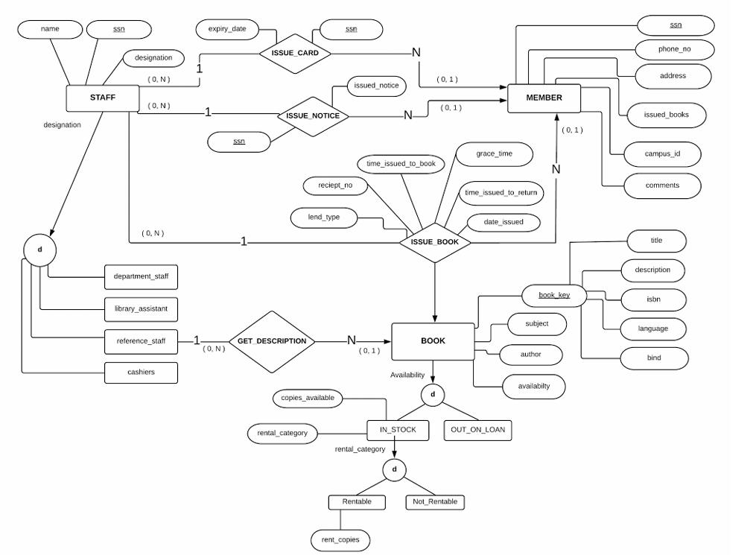
DIAGRAMS ER DIAGRAM

Slide 13
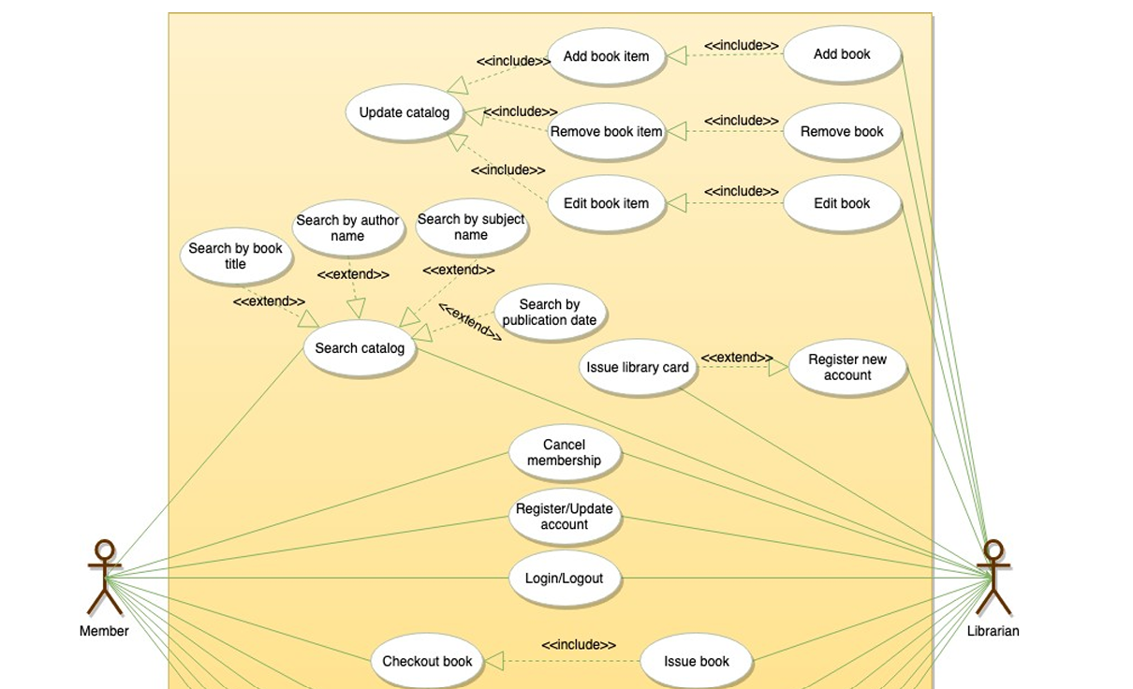
DIAGRAMS USE CASE DIAGRAM

Slide 14
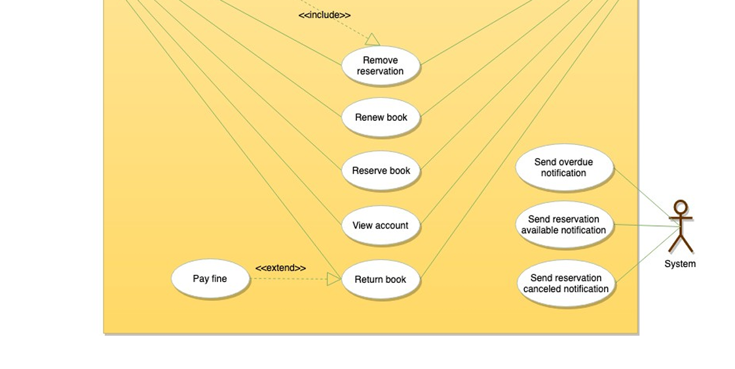
DIAGRAMS USE CASE DIAGRAM

Slide 15
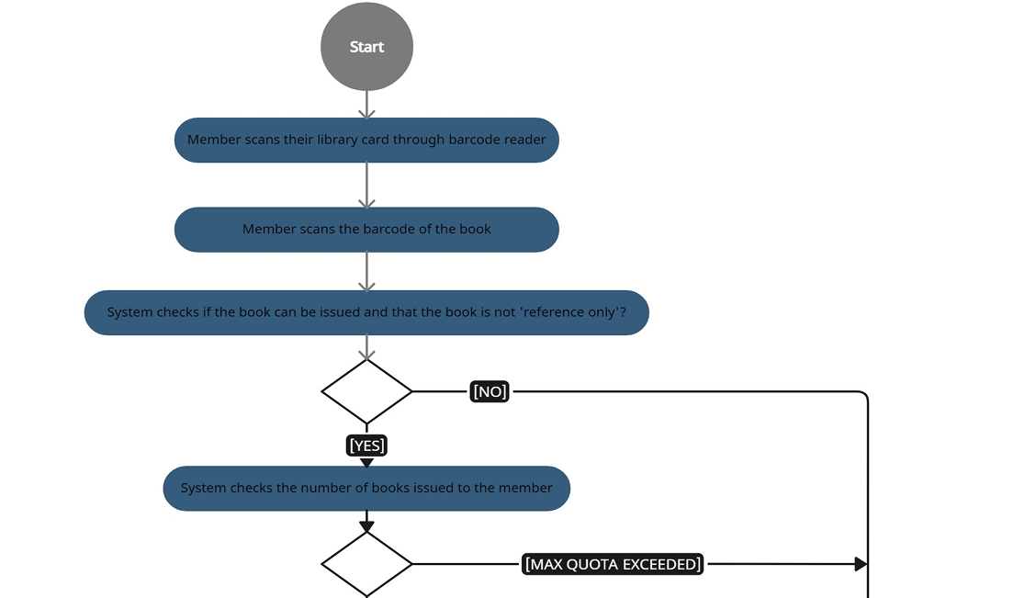
DIAGRAMS USE CASE DIAGRAM

Slide 16
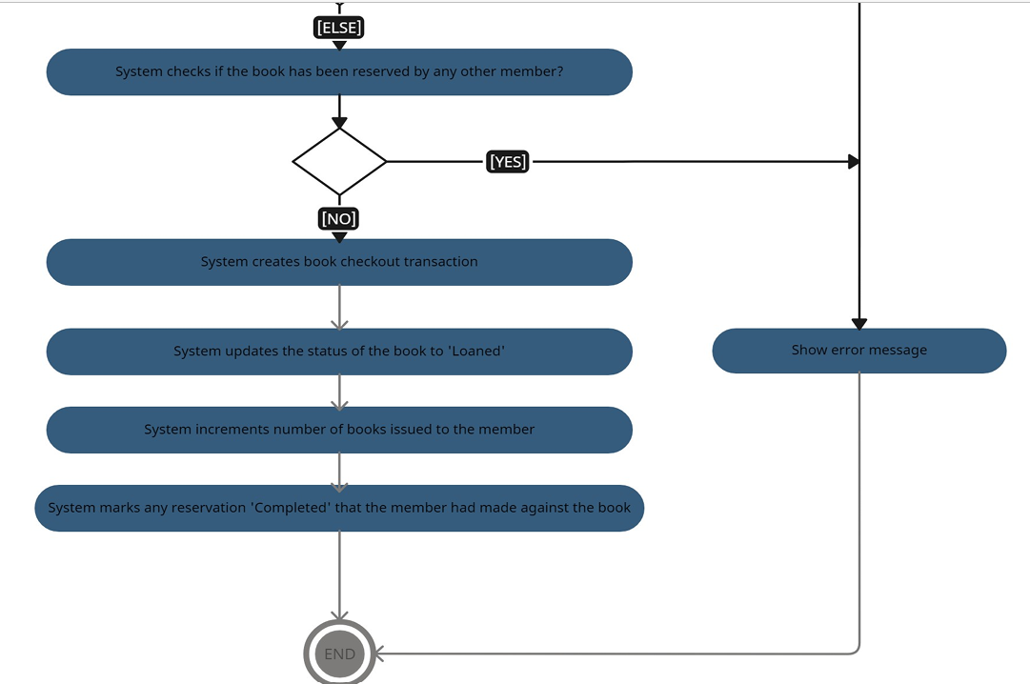
DIAGRAMS ACTIVITY DIAGRAM

Slide 17
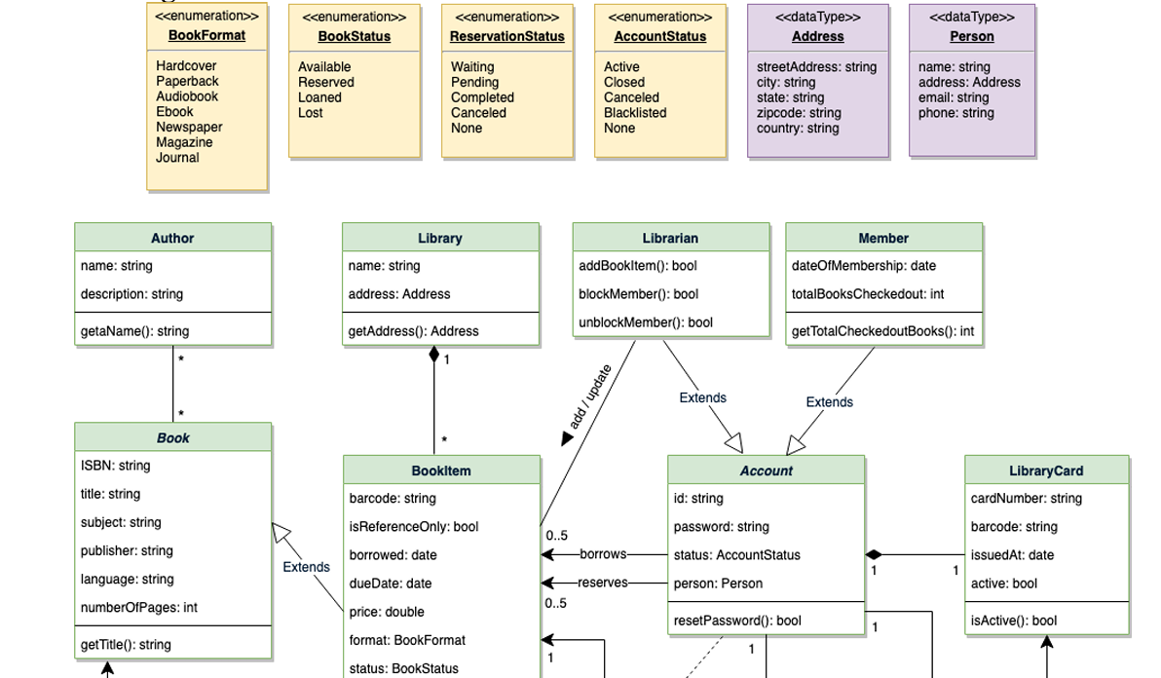
DIAGRAMS CLASS DIAGRAM

Slide 18
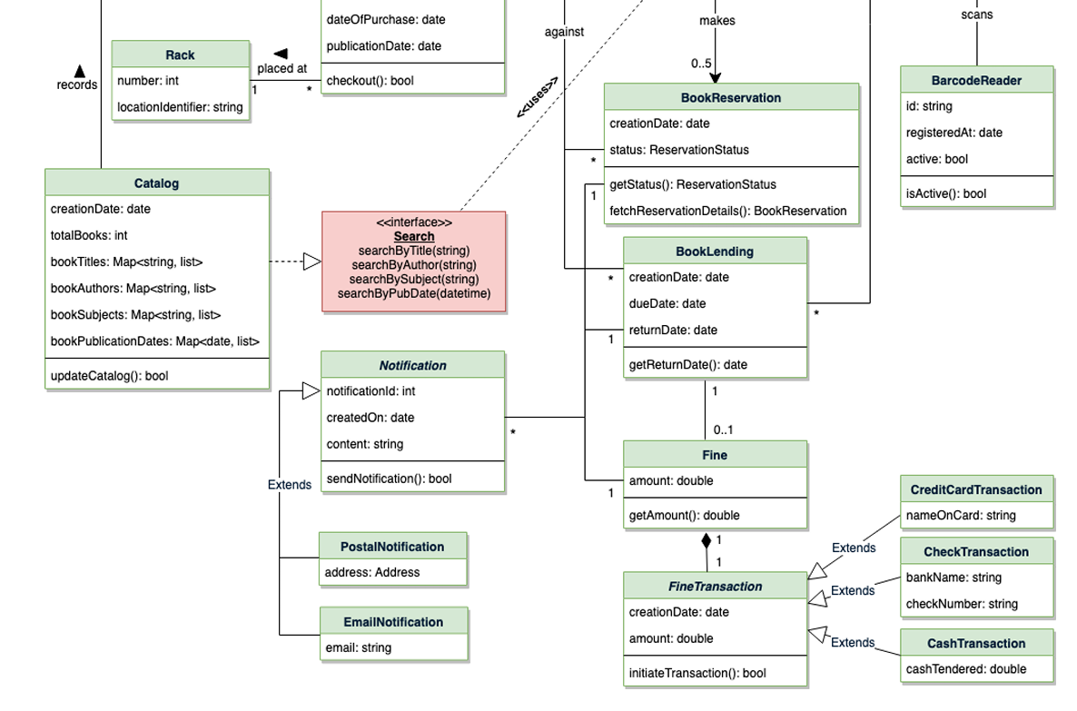
DIAGRAMS CLASS DIAGRAM

Slide 19
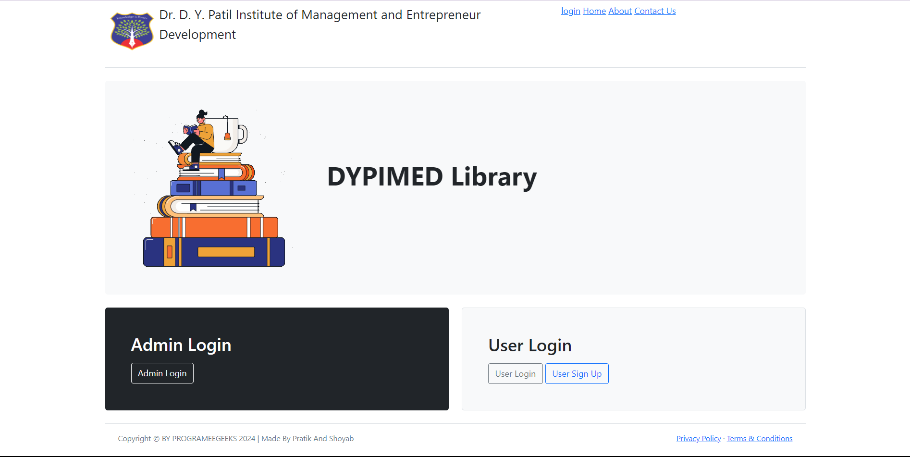
USER INTERFACES: HOME PAGE

Slide 20
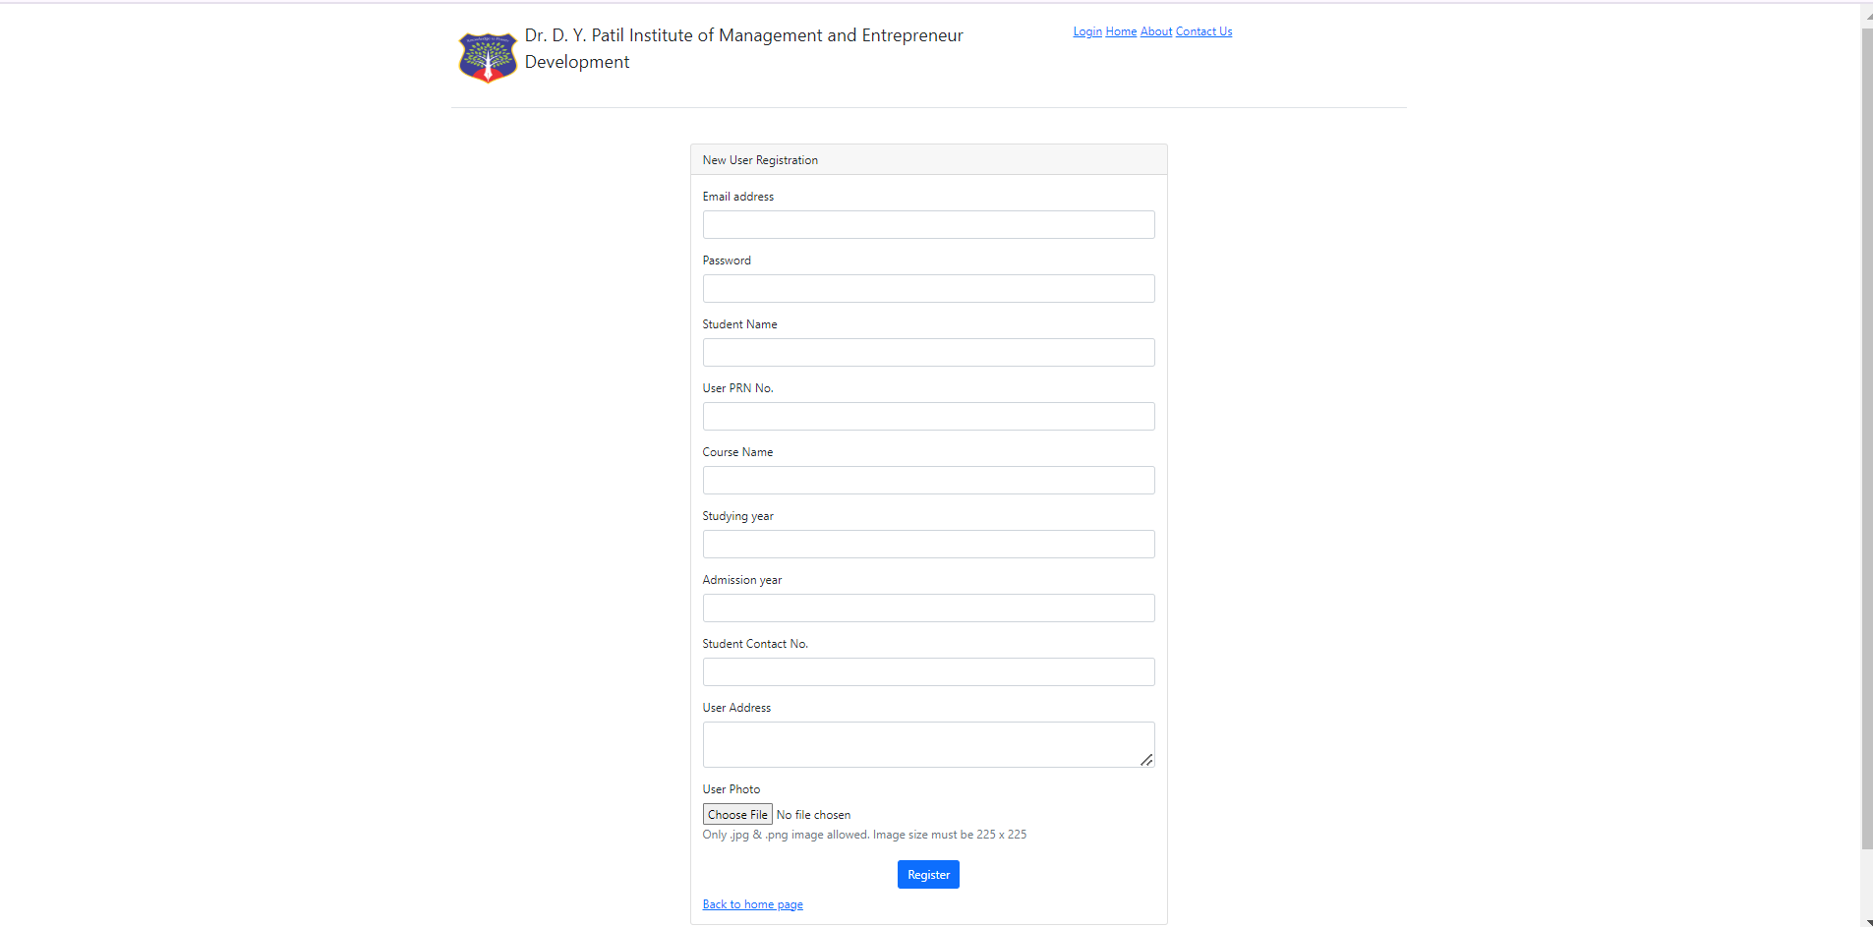
USER INTERFACES: REGISTRATION PAGE

Slide 21
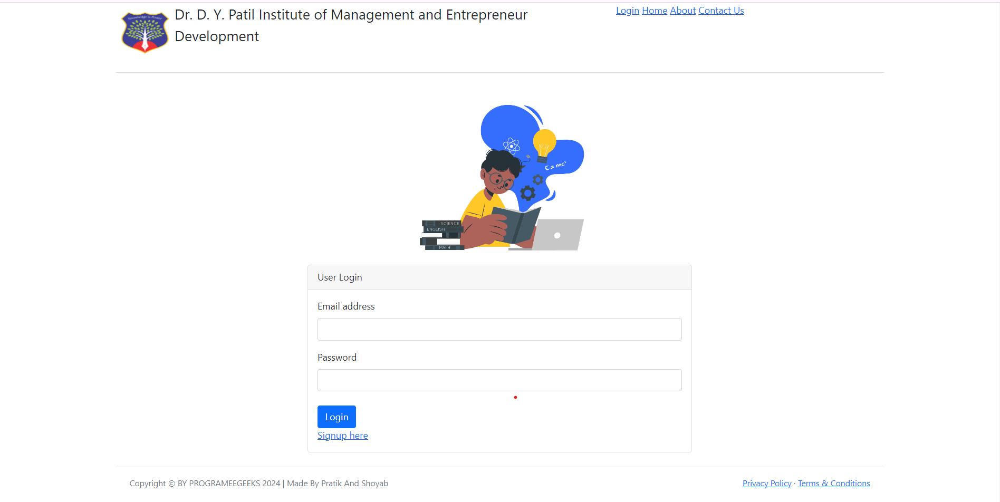
USER INTERFACES: LOGIN PAGE

Slide 22
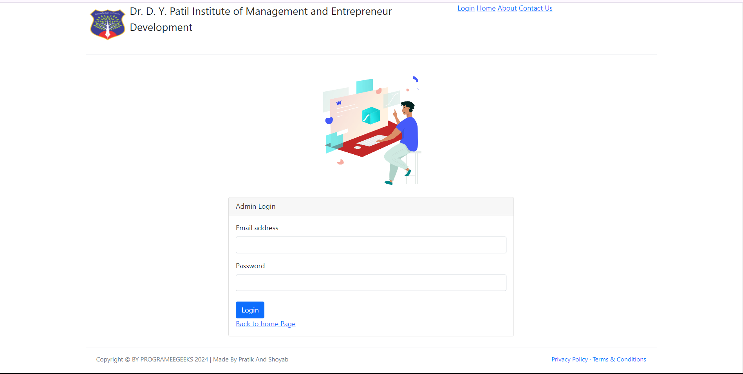
USER INTERFACES: ADMIN LOGIN PAGE

Slide 23
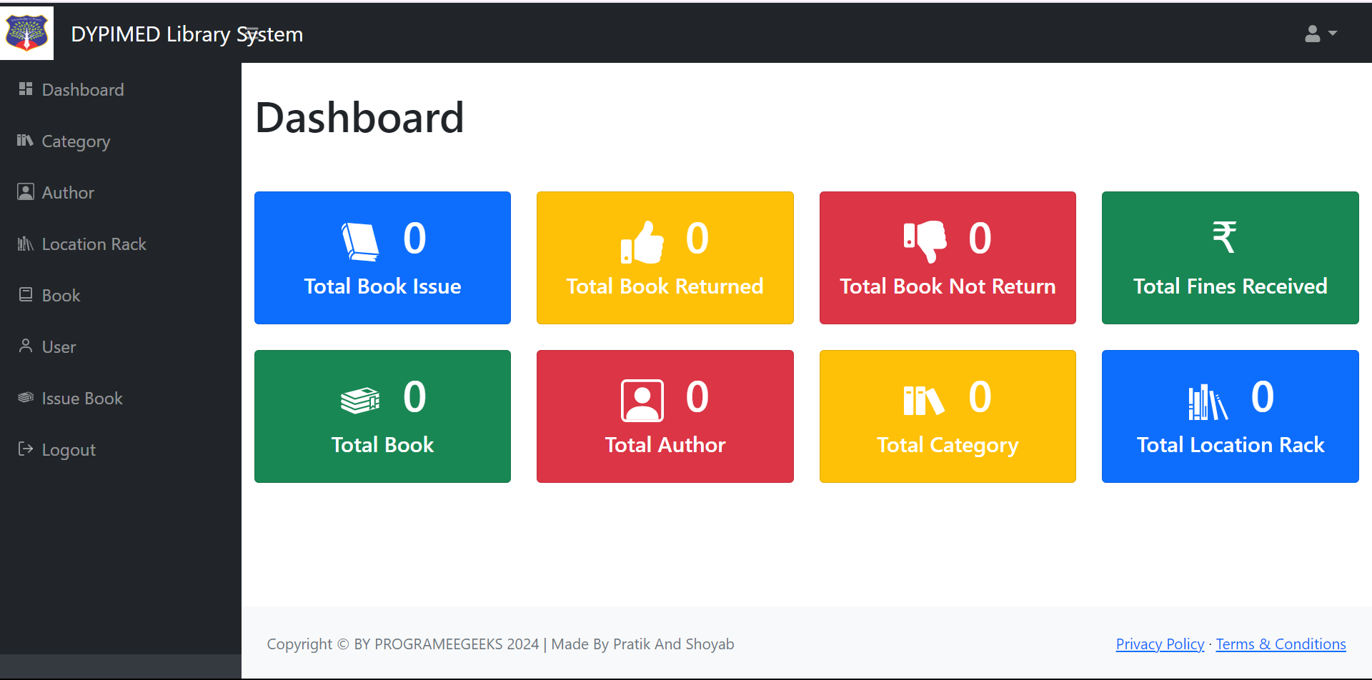
USER INTERFACES: ADMIN DASHBOARD

Slide 24
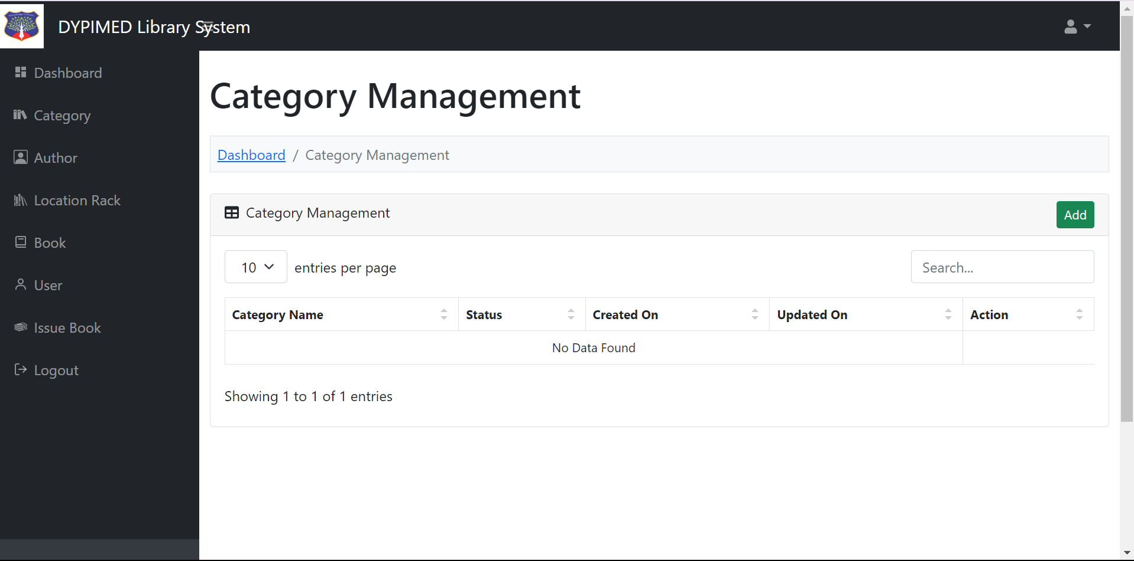
USER INTERFACES: ADD/MANAGE CATEGORY

Slide 25
USER INTERFACES: ADD/MANAGE CATEGORY

Slide 26
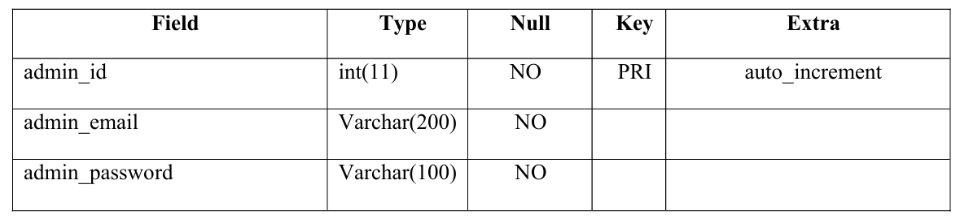
TABLES: 1.ADMIN
lms_admin:

Slide 27
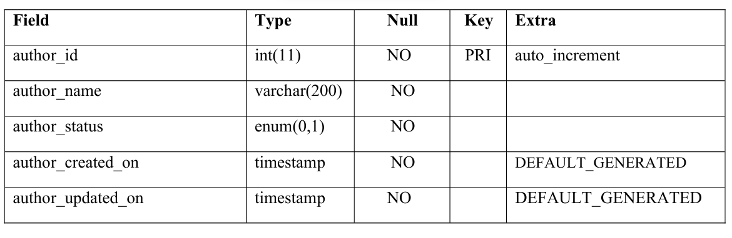
TABLES: 2.AUTHOR
lms_author:

Slide 28
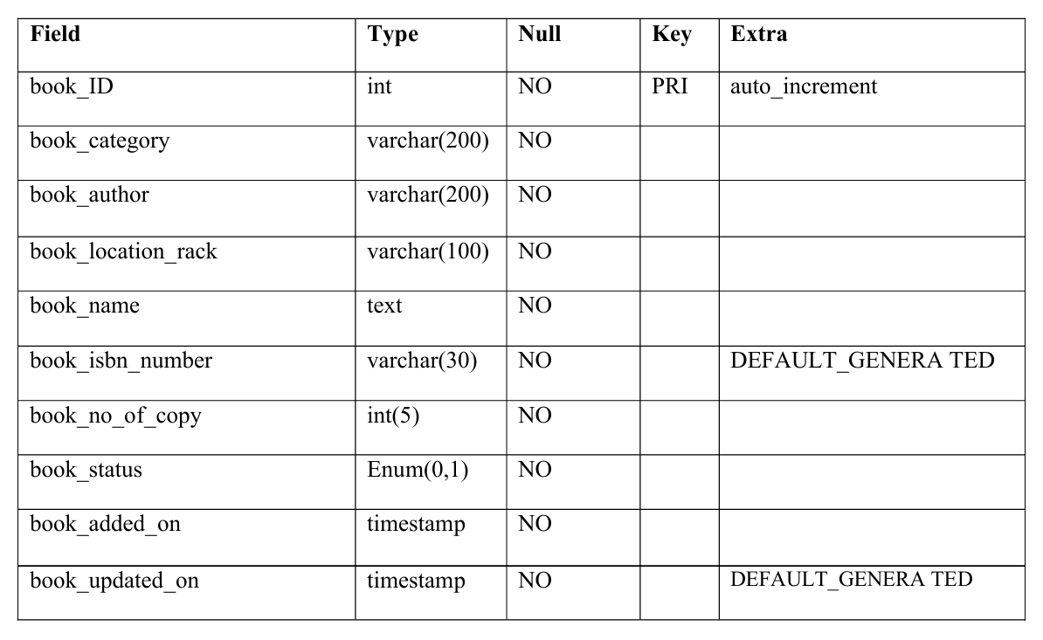
TABLES: 3.BOOKS
lms_book :

Slide 29
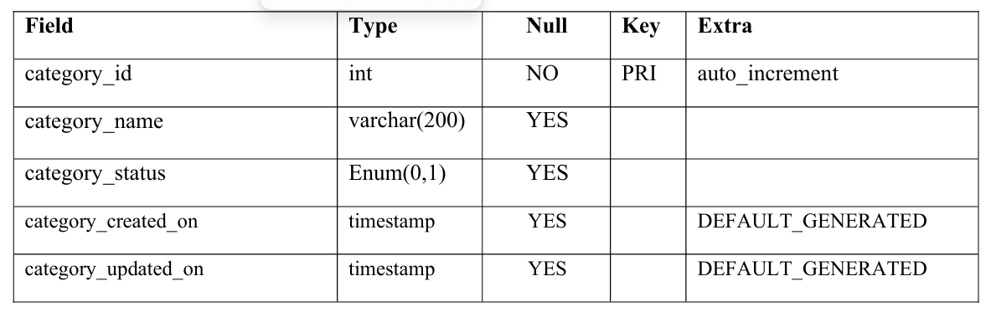
TABLES: 4.CATEGORIES
lms_category :

Slide 30
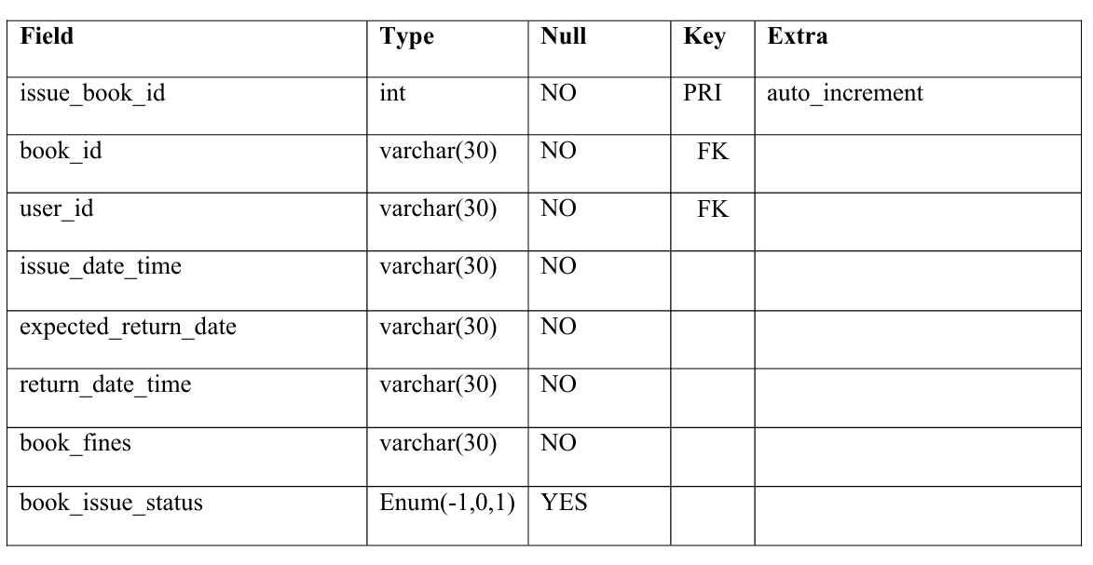
TABLES: 5.ISSUED BOOKS
lms_issue_book :

Slide 31
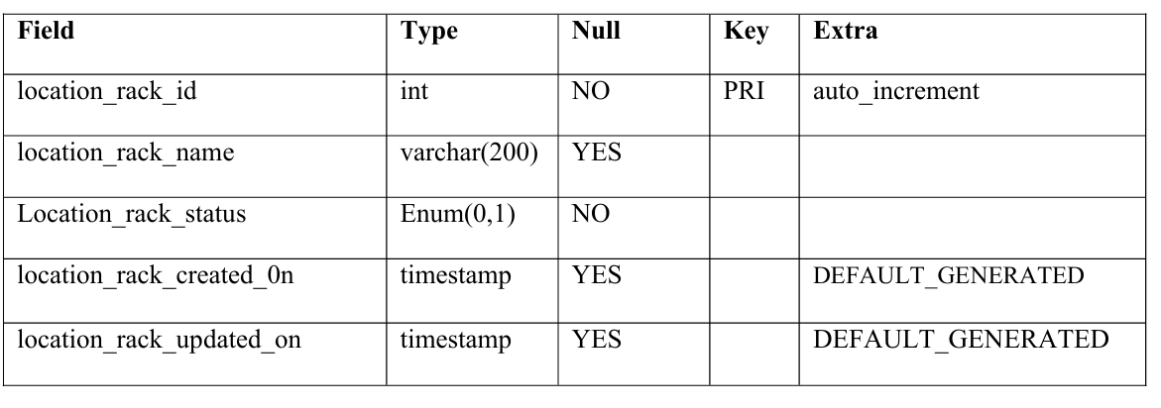
TABLES: 6.RACK LOCATION
lms_location_rack:

Slide 32
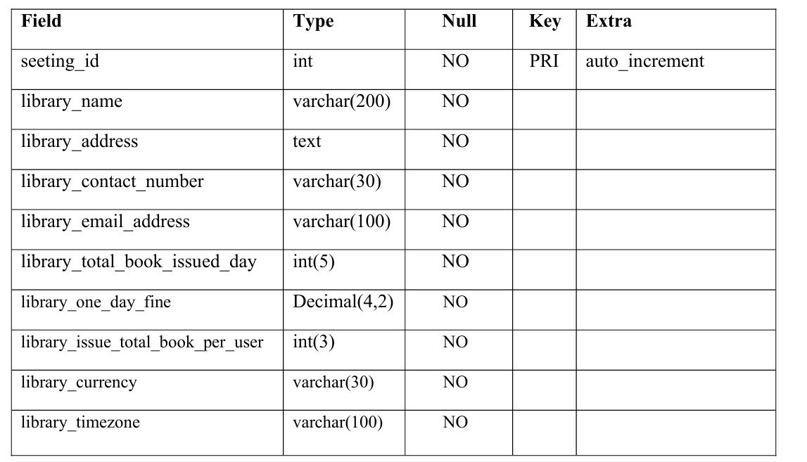
TABLES: 7.SETTING
lms_setting:

Slide 33
ADVANTAGES & DISADVANTAGES
Advantages:
Streamlined Process
Improved Accessibility
Enhanced Efficiency
Improved Candidate Experience
Disadvantages:
Initial investment
User Adoption
Maintenance and Updates
Dependency on technology

Slide 34
FUTURE SCOPE
Artificial Intelligence and Machine Learning:
Predictive Analytics
Blockchain Technology
Virtual Reality (VR) and Augmented Reality (AR)
Global Networking and Opportunities
Data Visualization and Reporting
Mobile Accessibility

Slide 35
CONCLUSION
In conclusion, implementing a Library Management System (LMS) offers a transformative solution for modernizing and streamlining library operations. This feasibility study shows that the LMS is a viable project across technical, economic, operational, and schedule aspects, providing a clear path for enhancing efficiency, accessibility, and resource management within the library. By automating processes such as cataloging, inventory tracking, user management, and notifications, the LMS significantly reduces manual workload, enabling library staff to focus more on serving patrons effectively.

Slide 36


